Slide 1

Welcome Back
2020-2021

Slide 2
Welcome to a Most Unusual Year
Your GREA has been and will continue to advocate for you in many ways:
Negotiating your contract last year View 2019-2022 Contract
Representing your interests on district reopening committees
Voicing your concerns to the Board and the community
Striving to ensure we all return to in-person instruction only when it’s safe
  View 8/17/20 Letter to BOE
  View 8/25/20 Letter to BOE

Slide 3
Welcome New Members
GREA is made up of your fellow teachers, administrative support staff, paraprofessionals and custodians.
As a member of the GREA you become part of a community of individuals who are dedicated to the education profession, the students of Glen Ridge and each other.
Your local leadership and association representatives are here to support you:
as you assimilate into this community and throughout your tenure in this district
to answer any questions you may have about your professional rights and responsibilities
to make you aware of the many resources that are available to you

Slide 4
Executive Board
Exec Board Positions
Exec Board Positions
President - MaryLynn Savio
Vice President - Lisa Petruzzi
Treasurer - Lillian Serghides
Grievance Chairs - Jenelle Hamer & Lisa Petruzzi
Recording Secretary - Stacy Amanna
Corresponding Secretary - Cathy Ciccone

Slide 5
Building Representatives
Central | Forest | Linden | RAS | GRHS
Megan Connolly | Charlene Reilly Kim Waldron | Jennifer Gonzaga Lisa Jacobsen | Doug Hellstern Jarrad Nardiello Samantha Odell | Kostas Barkouras Matt Cannici Jackie Cerone Emily Ramos
Please reach out to these individuals if you should have any questions or concerns.
Building Reps will be reaching out to our new members in the very near future.

Slide 6

Committee Chairs
Social/Member Involvement Chairs - Amanda Goodwin & Jenelle Hamer
Fundraising/Scholarship Chairs - Genine D’Andrea & Heather Kobylinski
Health & Safety Committee Chairs - Charlene Reilly & Kim Waldron
Communications Chair - Matt Cannici
Legislative Chair - Shirley Wujek
Pride & PR - Emily Ramos
Action Chair - Cluny Mendez

Slide 7
Chapter 78 Relief Legislation
Those employed prior to this year may retain their existing health plan and continue contributing the same portion of the insurance premium as per Chapter 78.
On Jan. 1, 2021, those interested in reducing their healthcare contributions will have the option of switching to:
The Horizon NJ Educators Health Plan (NJEHP)
Premium sharing for this plan will be based on a % of salary as opposed to % of the premium.
For full details, please review the charts at njea.org/jobjustice

Slide 8
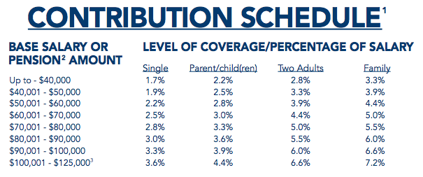
The NJ Educators Health Plan (NJEHP)
For full details, please review the charts at njea.org/jobjustice

Slide 9
Chapter 78 Relief Legislation
All new employees hired after on or after July 1, 2020 must take the NJEHP as of Jan. 1, 2021.
If you are hired after July 1, 2020, but prior to December 31, 2020, you will receive the health benefits that a new employee is entitled to under the collective bargaining agreement.
When Jan. 1, 2021 comes, you will automatically be enrolled in the NJEHP.

Slide 10
Chapter 78 Relief Legislation
Another new plan, the Garden State Health Plan (GSHP), will be available July 1, 2021.
That plan is entirely voluntary. No employee will be required to take it.
Those who do will see a premium sharing reduction of up to 50% from the NJEHP.

Slide 11
GREA Meeting Dates
All meetings will be VIRTUAL until further notice
General Membership Meeting Weds Aug 26, 2020
General Membership Meeting Thurs Nov 19, 2020
General Membership Meeting Thurs March 25, 2021
Additional meetings/info sessions will be called as necessary.

Slide 12
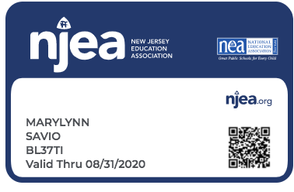
NEA Complimentary Life Insurance
Go to www.njea.org
Login in using your NJEA PIN or email on file
Password is last 4 digits of your social security number
Click on MY NJEA - Member Benefits
Click on Insurance - NEA Complimentary Life Insurance
Identify your Beneficiary

Slide 13
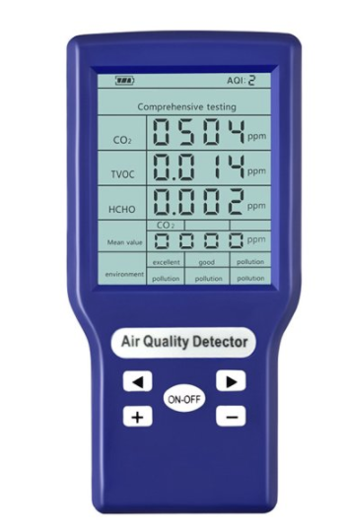
Monitoring Air Exchange Rate
In an effort to ensure as safe an environment as possible, we have purchased some CO₂ meter as suggested by our NJEA industrial hygiene consultant.
CO₂ levels indicating the air exchange rate can only be properly tested when people are occupying the space and is critical to ensuring proper ventilation.
At least one meter will be made available in each building. See your building rep if you would like to borrow it to test air flow in your space.

Slide 14
As we proceed to navigate what’s next:
Identify areas on concern and communicate with your building reps
Ideally attempt to personally address any individual concerns with your building administrators
Raise collective concerns or individual concerns that do not get adequately addressed to your building reps
Building reps will address building level concerns with principals
District level concerns will be raised to the Executive Board
Executive Board will address concerns to the Superintendent and the Board of Education as necessary

Slide 15


